Slide 1
Introduction to Artificial Intelligence
(Symbolic AI)
Siphokazi Tswane

Slide 2
Subject Guide
Term Dates
Assessments
Term 1 – Individual Assignment (20%)
Term 2 - Individual Assignment (10%) , Test (20%)
Term 3 – Group Project (10%), Test (10%)
Term 4 – Final Test 30%

Slide 3
Introduction to Artificial Intelligence
Lecture 1

Slide 4
Introduction to AI
AI Definition
Related Fields
History of AI
AI Philosophy
Applications of AI (Planning, understanding, natural language processing, parallel and distributed AI, learning, connectionist model, robotics, expert systems, fuzzy logic, artificial neural networks)

Slide 5
Learning Objectives
In this chapter, students are expected to:
gain an understanding the foundational perspectives and definitions of AI;
know how these foundational perspectives have influenced AI research and AI applications;
discover the historical trends in AI;
know about the diverse fields of application of AI; and
have a basic understanding of some specific application areas of AI

Slide 6
Quick Quiz
Mention some application areas in real life where you think Artificial Intelligence (AI) can be relevant?
Identify some problems in South Africa that you think A.I can solve?
What about CPUT?

Slide 7
Lecture Outline
What is AI
Attempting to Define AI
Definitional Perspectives of AI
Historical Trend of AI
Old AI vs. New AI
The Physical Symbol System Hypothesis
Good Old Fashioned Artificial Intelligence (GOFAI)
Situated and Embodied Artificial Intelligence (SEAL)
Areas of New AI
Artificial Life
Evolution
Artificial Development
Artificial Neural Networks
Artificial Immune Systems
Swarm Intelligence

Slide 8
8
Defining AI
Artitificial
Intelligence
Notes:
What do you do when you encounter a new term?
How would you go about defining AI?

Slide 9
Defining AI
Artitificial
Intelligence
Not occuring in nature, but made by man and
Ability to acquire and apply knowledge
Knowing thoroughly
State or fact of knowing
Possessing knowledge, Intelligence or understanding

Slide 10
Defining AI
What is, and what isn't AI?
No officially agreed definition
The legacy of science fiction
What seems easy is actually hard…
…and what seems hard is actually easy
So what would be a more useful definition?
An attempt at a definition more useful than the “what computers can't do yet” joke would be to list properties that are characteristic to AI, in this case autonomy and adaptivity.
Autonomy
The ability to perform tasks in complex environments without constant guidance by a user.
Adaptivity
The ability to improve performance by learning from experience.
Notes:
AI is currently a “hot topic”: media coverage and public discussion about AI is almost impossible to avoid. However, you may also have noticed that AI means different things to different people. For some, AI is about artificial life-forms that can surpass human intelligence, and for others, almost any data processing technology can be called AI.
Even AI researchers have no exact definition of AI. The field is rather being constantly redefined when some topics are classified as non-AI, and new topics emerge. There’s an old (geeky) joke that AI is defined as “cool things that computers can’t do.” The irony is that under this definition, AI can never make any progress: as soon as we find a way to do something cool with a computer, it stops being an AI problem. However, there is an element of truth in this definition. Fifty years ago, for instance, automatic methods for search and planning were considered to belong to the domain of AI. Nowadays such methods are taught to every computer science student. Similarly, certain methods for processing uncertain information are becoming so well understood that they are likely to be moved from AI to statistics or probability very soon.
the legacy of science fiction
The confusion about the meaning of AI is made worse by the visions of AI present in various literary and cinematic works of science fiction. Science fiction stories often feature friendly humanoid servants that provide overly-detailed factoids or witty dialogue, but can sometimes follow the steps of Pinocchio and start to wonder if they can become human. Another class of humanoid beings in sci-fi espouse sinister motives and turn against their masters in the vein of old tales of sorcerers’ apprentices, going back to the Golem of Prague and beyond. Sometimes science fiction portrays AI in terms of robots that are badass, genius and powerful than human being to an extent that one may think that people can be replaced by machines. This alienates people and they become negative towards AI.
Reason 3: what seems easy is actually hard…
Another source of difficulty in understanding AI is that it is hard to know which tasks are easy and which ones are hard. Look around and pick up an object in your hand, then think about what you did: you used your eyes to scan your surroundings, figured out where are some suitable objects for picking up, chose one of them and planned a trajectory for your hand to reach that one, then moved your hand by contracting various muscles in sequence and managed to squeeze the object with just the right amount of force to keep it between your fingers. It can be hard to appreciate how complicated all this is, but sometimes it becomes visible when something goes wrong: the object you pick is much heavier or lighter than you expected, or someone else opens a door just as you are reaching for the handle, and then you can find yourself seriously out of balance. Usually these kinds of tasks feel effortless, but that feeling belies millions of years of evolution and several years of childhood practice. While easy for you, grasping objects by a robot is extremely hard, and it is an area of active study.
…and what seems hard is actually easy
By contrast, the tasks of playing chess and solving mathematical exercises can seem to be very difficult, requiring years of practice to master and involving our “higher faculties” and concentrated conscious thought. Since machines can do this wiyth ease does it mean they are more intelligent than people???
It has since turned out that playing chess is very well suited to computers, which can follow fairly simple rules and compute many alternative move sequences at a rate of billions of computations a second. Computers beat the reigning human world champion in chess in the famous Deep Blue vs Kasparov matches in 1997. Could you have imagined that the harder problem turned out to be grabbing the pieces and moving them on the board without knocking it over! We will study the techniques that are used in playing games like chess or tic-tac-toe in Chapter 2. Similarly, while in-depth mastery of mathematics requires (what seems like) human intuition and ingenuity, many (but not all) exercises of a typical high-school or college course can be solved by applying a calculator and simple set of rules.
So what would be a more useful definition?
An attempt at a definition more useful than the “what computers can't do yet” joke would be to list properties that are characteristic to AI, in this case autonomy and adaptivity.
Autonomy
The ability to perform tasks in complex environments without constant guidance by a user.
Adaptivity
The ability to improve performance by learning from experience.

Slide 11
Practical Definitions of AI
Systems that think like humans
"The exciting new effort to make computers think . . . machines with minds, in the full and literal sense." (Haugeland, 1985)
"[The automation of] activities that we associate with human thinking, activities such as decision-making, problem solving, learning . . ." (Bellman, 1978)
Systems that think rationally
"The study of mental faculties through the use of computational models." (Chamiak and McDermott, 1985)
The study of the computations that make it possible to perceive, reason, and act.“ (Winston, 1992)
Notes:
The first definitions are concerned with thought processes and reasoning, whereas the ones LAST TWO address behavior.
The definitions AT THE TOP measure success in terms of fidelity to human performance, whereas RATIONALITY the ones on the right measure against an ideal performance measure, called rationality.
A system is rational if it does the “right thing,” given what it knows. Historically, all four approaches to AI have been followed, each by different people
with different methods.
A human-centered approach must be in part an empirical science ("based on observation or experience”), involving observations and hypotheses about human behavior. A rationalist approach involves a combination of mathematics and engineering.
a combination of mathematics and engineering. The various group have both disparaged and
helped each other. Let us look at the four approaches in more detail.

Slide 12
Practical Definitions of AI
Systems that act like humans
"The art of creating machines that perform functions that require intelligence when performed by people." (Kurzweil, 1990)
"The study of how to make computers do things at which, at the moment, people are better." (Rich and Knight, 1991)
Systems that act rationally
"Computational Intelligence is the study of the design of intelligent agents." (Poole et al., 1998)
"A1 . . .is concerned with intelligent behavior in artifacts." (Nilsson, 1998)
Notes:
The first definitions are concerned with thought processes and reasoning, whereas the ones LAST TWO address behavior.
The definitions AT THE BOTTOM measure success in terms of fidelity to human performance, whereas RATIONALITY the ones on the right measure against an ideal performance measure, called rationality.
A system is rational if it does the “right thing,” given what it knows. Historically, all four approaches to AI have been followed, each by different people
with different methods.
A human-centered approach must be in part an empirical science ("based on observation or experience”), involving observations and hypotheses about human behavior. A rationalist approach involves a combination of mathematics and engineering.
a combination of mathematics and engineering. The various group have both disparaged and
helped each other. Let us look at the four approaches in more detail.

Slide 13
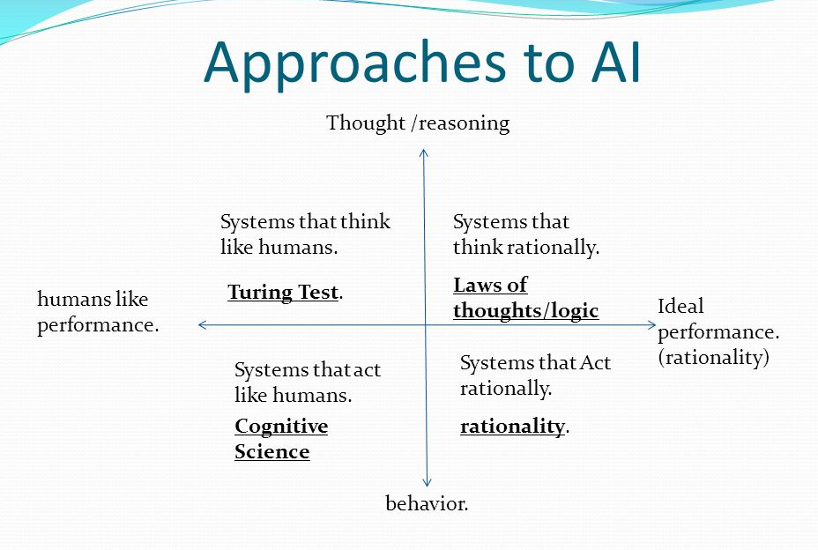

Slide 14
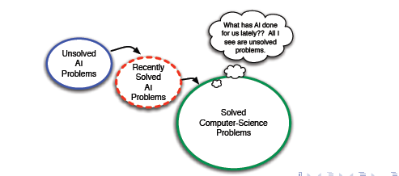
Unsolved problems in artificial Intelligence (AI)
Notes:
Broadly, the unsolved problems in artificial Intelligence (AI) are as following: Integrating all AI fields, as machine learning, computational intelligence, knowledge engineering, cognitive science, artificial neural networks, or data science and engineering.

Slide 15
What is the Nature of AI problems vs. Non-AI problems?
A.I Problems
Non A.I Problems
They are poorly Circumscribable
Solution is either rated as adequate or inadequate;
Solution is not testably correct
Has poor modular approximation
They are perfectly circumscribable
Have exact solution
There is absolute correctness
Has good modular approximation
Notes:
Circumscribable - restrict (something) within limits.
submodular set function is a set function whose value, informally, has the ... suitable for many applications
Approximation - a value or quantity that is nearly but not exactly correct.

Slide 16
Related Fields
Machine learning
subfield of AI, which itself is a subfield of Computer Science
Machine learning enables AI solutions that are adaptive.
Machine learning can be defined as systems that improve their performance in a given task with more and more experience or data.
Deep learning
is a subfield of machine learning, which itself is a subfield of AI, which itself is a subfield of computer science.
Refers to the complexity of a mathematical model, and that the increased computing power of modern computers has allowed researchers to increase this complexity to reach levels that appear not only quantitatively but also qualitatively different from before.
Notes:
Machine learning can be said to be a subfield of AI, which itself is a subfield of computer science (such categories are often somewhat imprecise and some parts of machine learning could be equally well or better belong to statistics). Machine learning enables AI solutions that are adaptive. A concise definition can be given as follows:
Key terminology
Machine learning
Systems that improve their performance in a given task with more and more experience or data.
Deep learning is a subfield of machine learning, which itself is a subfield of AI, which itself is a subfield of computer science. We will meet deep learning in some more detail in Chapter 5, but for now let us just note that the “depth” of deep learning refers to the complexity of a mathematical model, and that the increased computing power of modern computers has allowed researchers to increase this complexity to reach levels that appear not only quantitatively but also qualitatively different from before. As you notice, science often involves a number of progressively more special subfields, subfields of subfields, and so on. This enables researchers to zoom into a particular topic so that it is possible to catch up with the ever increasing amount of knowledge accrued over the years, and produce new knowledge on the topic — or sometimes, correct earlier knowledge to be more accurate.

Slide 17
Related Fields cont’d
Data science
is a recent umbrella term (term that covers several subdisciplines) that includes machine learning and statistics, certain aspects of computer science including algorithms, data storage, and web application development.
Data science is also a practical discipline that requires understanding of the domain in which it is applied in
E.g. business or science: its purpose (what "added value" means), basic assumptions, and constraints.
Data science solutions often involve at least a pinch of AI.
Notes:
Data science is a recent umbrella term (term that covers several subdisciplines) that includes machine learning and statistics, certain aspects of computer science including algorithms, data storage, and web application development. Data science is also a practical discipline that requires understanding of the domain in which it is applied in, for example, business or science: its purpose (what "added value" means), basic assumptions, and constraints. Data science solutions often involve at least a pinch of AI (but usually not as much as one would expect from the headlines).

Slide 18
Related Fields cont’d
Robotics
is about building and programming robots so that they can operate in complex, real-world scenarios.
it requires a combination of virtually all areas of AI. Such as:-
Computer vision and speech recognition for sensing the environment
Natural language processing, information retrieval, and reasoning under uncertainty for processing instructions and predicting consequences of potential actions
Cognitive modeling and affective computing (systems that respond to expressions of human feelings or that mimic feelings) for interacting and working together with humans
Many of the robotics-related AI problems are best approached by machine learning, which makes machine learning a central branch of AI for robotics.
Notes:
Robotics means building and programming robots so that they can operate in complex, real-world scenarios. In a way, robotics is the ultimate challenge of AI since it requires a combination of virtually all areas of AI. For example:
Computer vision and speech recognition for sensing the environment
Natural language processing, information retrieval, and reasoning under uncertainty for processing instructions and predicting consequences of potential actions
Cognitive modeling and affective computing (systems that respond to expressions of human feelings or that mimic feelings) for interacting and working together with humans
Many of the robotics-related AI problems are best approached by machine learning, which makes machine learning a central branch of AI for robotics.
Note

